Slide 1
Detect Emotion of Image through Deep Learning
Group 5
MSCA 31009
Machine Learning and Predictive Analysis
Github:

Slide 2
Our Team
Dongni Yang
Jasmine Yi
Jiawei Yu

Slide 3
TABLE OF CONTENTS
01
02
03
04
Problem Statement
Exploratory Data Analysis
Feature Engineering and Transformation
Model Analysis
05
Model Selection
06
Result & Future Work

Slide 4
01
Problem Statement

Slide 5
Problem Statement
A facial expression is one or more motions of the muscles beneath the skin of the face. These movements convey the emotional state of an individual to observers. Facial expressions are a form of nonverbal communication. They are a primary means of conveying social information between humans. The eyes are often viewed as important features of facial expressions. People can tell whether a man is lying through his blinking rate.
We want to find out whether people are smiling and differentiate real smiles from fake smiles.

Slide 6
02
Exploratory Data Analysis

Slide 7


Dataset
SOURCE
SIZE
CLASS
https://github.com/hromi/SMILEsmileD
1.3K images
Smile vs Other
(positive)
(negative)

Slide 8
Exploratory Data Analysis
Our data is image data contains different people’s facial expressions. The majority of them contains different level of smile on people’s face. For those “Non-smiling” picture, some contains no expressions, some have other expressions like anger, surprise, sadness and confusion.
The images are 64x64, black and white images, with one channel of grayscale.
We split the data into training and testing dataset. Training dataset contains 80% of the whole dataset and testing dataset contains the 20% of the whole dataset.
2927 images with smile and 7363 images with no smile in training dataset
763 images with smile and 2115 images with no smile in test dataset

Slide 9
03
Feature Engineering & Transformation

Slide 10
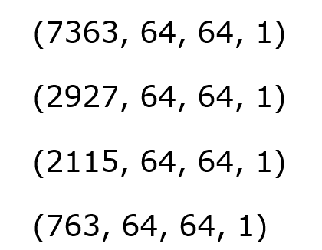
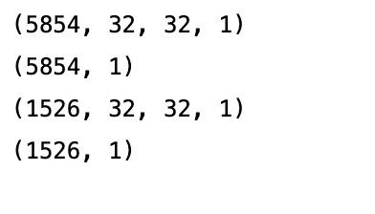
Feature Engineering & Transformation
Reshape the image data to 32x32 to reduce the pixels, saving running time and prepare for upcoming model fitting
We detected mild imbalance in our dataset. Smiling images takes 22.3% of the data
Downsample the dataset to balance the proportion of smiling and non-smiling images. Also reduce the outlier in the dataset.
Train_negative
Train_positive
Test_negative
Test_positive
Train_x
Train_y
Test_x
Test_y
Downsample
Notes:
Reshape for random forest and boosting
https://developers.google.com/machine-learning/data-prep/construct/sampling-splitting/imbalanced-data

Slide 11
04
Model Analysis

Slide 12
Random Forest
Advantages:
Being capable of using continuous and categorical data sets
Good at dealing with outliers in training data
Uses randomness to enhance its accuracy and combat overfitting
Tune Parameters:
N_estimators: controls the number of trees
Max_depth: defined as the longest path between the root node and the leaf node
Min_samples_leaf: specifies the minimum number of samples that should be present in the leaf node after splitting a node
The more you decrease n_estimators, increase max_depth or increase min_samples_leaf, more is the possibility of overfitting.
Notes:
RF - best params image
Cross validation tuning parameter(码）
Report
Compare results between balanced and imbalanced data

Slide 13
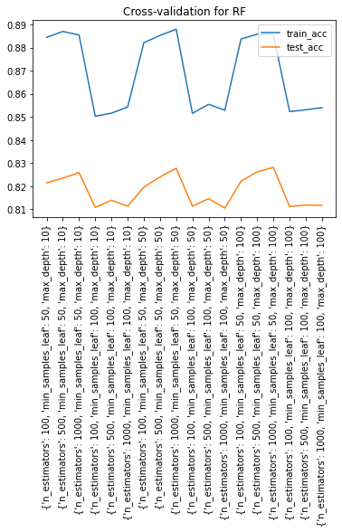
Random Forest
❴
❴
N_estimators: [100, 500, 1000]
Max_depth: [10, 50, 100]
Min_samples_leaf: [50, 100]
N_estimators: 1000
Max_depth: 100
Min_samples_leaf: 50
Best
N_estimators = 1000, max_depth = 100 and min_samples_leaf = 50 are the parameters that yield highest accuracy for validate dataset and has the best performance
train_acc
val_acc
For the best performance from CV, the accuracy for train average is 0.88 and the accuracy for test average is 0.83. The difference is small. No overfitting.
The standard deviation for accuracy of test data is 0.008. The performance of this model is stable.
Notes:
RF - best params image
Cross validation tuning parameter(码）
Report
Compare results between balanced and imbalanced data

Slide 14
Gradient Boosting
Advantages:
Generates a combined model with lower errors
Has high flexibility that can optimize on different loss function and provide several hyperparameter tuning options
Tune Parameters:
N_estimators: represents the number of trees in the forest
Learning_rate: shrinks the contribution of each tree by learning_rate
Max_depth: indicates how deep the built tree can be
The more you increase n_estimators, increase learning_rate or increase max_depth, more is the possibility of overfitting.
Notes:
RF - best params image
Cross validation tuning parameter(码）
Report
Compare results between balanced and imbalanced data

Slide 15
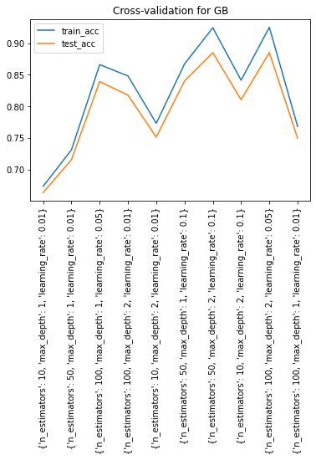
Gradient Boosting
❴
❴
N_estimators: [10, 50, 100]
Learning_rate: [0.01, 0.05, 0.1]
Max_depth: [1,2]
N_estimators: 100
Learning_rate: 0.05
Max_depth: 2
Best
N_estimators = 100, max_depth = 2 and learning_rate = 0.05 are the parameters that yield highest accuracy for validate dataset
train_acc
val_acc
Cross validation gives the average accuracy for train data is 0.88 and the average accuracy for validate data is 0.83. he difference is small. No overfitting.
The standard deviation for accuracy of validate data is 0.008. The performance of this model is stable.
Notes:
RF - best params image
Cross validation tuning parameter(码）
Report
Compare results between balanced and imbalanced data

Slide 16
Convolutional Neural Networks
Advantages:
captures the arrangement of pixels and the relationship between them in an image.
CNN-LeNet5:
being made up of 3 convolutional layers, 2 subsampling layers and 2 fully connected layers
Tune Parameters:
Epoch: times when entire dataset is passed forward and backward through the neural network
Learning_rate: controls how much to change the model in response to the estimated error each time the model weights are updated
The more you increase epoch number the more it takes to train the neural network. The more increase learning_rate, much faster in learning the sub-optimal set of weights, causing an unstable process
Notes:
RF - best params image
Cross validation tuning parameter(码）
Report
Compare results between balanced and imbalanced data

Slide 17
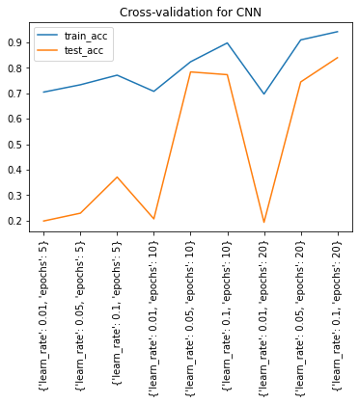
Convolutional Neural Networks
❴
❴
Learning_rate: [0.01, 0.05, 0.1]
Epochs: [5, 10, 20]
Learning_rate: 0.05
Epochs: 10
Best
Best Performance from CV
Learning rate = 0.1 and epochs = 20 are the parameters that yield highest accuracy of 0.83 for validate data. The average accuracy for train data is 0.94. The gap between them is large, indicating overfitting.
train_acc
val_acc
Best Parameters we select
So, we choose the model that provides second highest accuracy. learning rate = 0.05 and epochs = 10 provide the average accuracy of 0.78 for validate data and average accuracy of 0.82 for train data. No overfitting.
The standard deviation for accuracy of validate data is 0.07. The performance of this model is stable.
Notes:
RF - best params image
Cross validation tuning parameter(码）
Report
Compare results between balanced and imbalanced data

Slide 18
05
Model Selection

Slide 19
Model Selection
 | Train_ACC | Test_ACC | Train_RMSE | Test_RMSE
Convolutional Neural Network | 0.86 | 0.81 | 0.102 | 0.142
Random Forest | 0.89 | 0.81 | 0.111 | 0.191
Gradient Boosting | 0.84 | 0.78 | 0.159 | 0.216
Here is the Accuracy and RMSE table for our three best performance models after cross-validation. Although Random Forest and CNN have the same accuracy for test data, we choose CNN as our final selection. CNN has the smallest difference between train accuracy and test accuracy as well as the lowest RMSE score for train data among all three models. Therefore, we believe that CNN suits our data the best, provides an accurate result and works stable in future training.

Slide 20
06
Results and Future Work

Slide 21
Conclusion
To perform the binary classification on image, we chose three models, Random Forest, Gradient Boosting, and CNN, from simple to complex to reach our goal.
Cross validation is used for parameter tuning to avoid overfitting problem and choose the parameter combo that provides the best performance.
Accuracy against parameter combo is plotted and overfitting is detected by calculating the gap between train accuracy and validation accuracy. Stableness is also reflected through the standard deviation of accuracy scores.
Convolutional Neural Network is the model we selected for the best performance, competing with Random Forest model and Gradient Boosting model.
Cross validation gives CNN the best parameters. learning rate = 0.05 and epochs = 10 provide a stable model with no overfitting problem.
The best Convolutional Neural Network gives 0.81 prediction accuracy on the testing data.

Slide 22
Future Work
Some images have mouth covered, which is a challenge for algorithm to detect.
We have imbalance data and we choose to down sampling our data for the small capacity of our machine. We wish to try up sampling as well to keep more information of the images and use them in the algorithm.
RandomSearchCV is used to select parameter combos. For better results, could try GridSearchCV for deeper research.
Increase the the number of parameters and the range of values for parameter tuning with cross validation .
Apply other layer combinations in CNN, and explore their performance

Slide 23
Thanks!
Do you have any questions?

